Slide 1
Employee Turnover Analysis
STUDENT NAME: M.Priyadharshini
REGISTER NO: 312200875
DEPARTMENT: B.COM (GENERAL)
COLLEGE: Pachaiyappa’s College For women
Kanchipuram.

Slide 2
PROJECT TITLE
EMPLOYEE TURNOVER ANALYSIS

Slide 3


AGENDA
Problem Statement
Project Overview
End Users
Our Solution and Proposition
Dataset Description
Modelling Approach
Results and Discussion
Conclusion
3/21/2024 Annual Review

Slide 4

PROBLEM STATEMENT
Turnover, within any organization, is an expensive process in terms of both direct and indirect costs. Looking specifically at voluntary turnover, companies often lose valued employees to other opportunities outside the organization. So, not only is voluntary turnover expensive in terms of replacing those employees, but it is potentially harmful to the productivity and culture of the company itself. Therefore, it has become increasingly important for companies to inform themselves of the research regarding proven predictors of voluntary turnover.

Slide 5

PROJECT OVERVIEW
.
Employee turnover data analysis is an HR analytics or people analytics process that involves collecting data, analyzing, and reporting HR data to help understand a company's turnover rate. Employee turnover data analysis helps you break turnover data down and get insights into what turnover looks like in your company.

Slide 6

WHO ARE THE END USERS?
Human Resources (HR) Managers:
Department Managers/Supervisors:
Senior Management/Executives:
Employees:

Slide 7

OUR SOLUTION AND ITS VALUE PROPOSITION
Identify trends
Analyzing turnover rates can help identify trends, such as a high turnover rate in a particular department or employees leaving for higher salaries.
Determine financial impact
Employee turnover data analysis can help determine the financial impact of turnover on the organization.
Identify turnover risk
Employee turnover data analysis can help identify the turnover risk among existing employees.

Slide 8
Dataset Description
Portobello Tech is an app innovator that has devised an intelligent way of predicting employee turnover within the company. It periodically evaluates employees' work details including the number of projects they worked upon, average monthly working hours, time spent in the company, promotions in the last 5 years, and salary level. Data from prior evaluations show the employee’s satisfaction at the workplace. The data could be used to identify patterns in work style and their interest to continue to work in the company. The HR Department owns the data and uses it to predict employee turnover. Employee turnover refers to the total number of workers who leave a company over a certain time period.

Slide 9

THE "WOW" IN OUR SOLUTION
A publication by the "African Journal of Business Management" outlines job coupling as a retention strategy. This model includes 2 dimensions: “on-job-coupling” and “off-job-coupling.” They delineate 3 factors — linkage, fitness, and sacrifice — as key determinants in educing employee turnover.
3/21/2024 Annual Review
9

Slide 10
MODELLING
How an employee perceives their compatibility with the organization is outlined by fitness. Are their personal goals and plans aligned with the company culture? Do their skills align well with the needs and demands of their job description? Additionally, fitness measures their affiliation with others within their work group and community. The theory suggests employees who find fitness within the organization will show higher job satisfaction and reduced inclination to leave.
10

Slide 11
MODELLING
Using this model for reducing turnover, businesses could look to provide staff with more opportunities to make deeper, more meaningful connections with the work and their colleagues. These linkages can help employees feel more allied with the organization rather than invisible. Does their work include opportunities to provide outreach or volunteer services or work? They may participate in employee resource committees that add yet another link to the organization and its staff members. Providing chances to interweave employees' personal goals and aspirations with the organization is key to reducing their desire to leave. The fitness aspect may be closely akin to today’s employee desire for work-life integration. Employees who believe in their company's values and social responsibility are better able to align their own beliefs to their work. On a day-to-day basis, businesses must assure staff members are challenged, but not frustrated, by the work they perform. Otherwise, the work may reduce engagement and lower employee morale. In the longer term, advancement should closely align with the employee’s own career objectives.
11

Slide 12
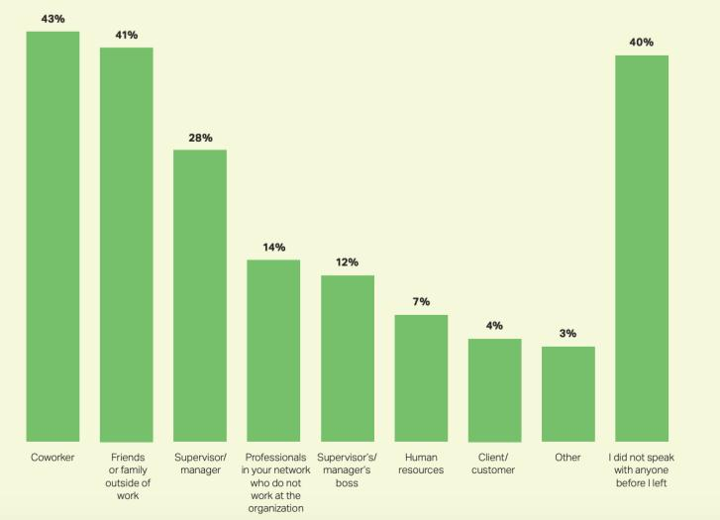
RESULTS
12

Slide 13
conclusion
Increased costs: It can be expensive to recruit, hire, and train new employees. Gallup estimates that replacing an employee can cost between half and twice their salary.
Reduced productivity: New employees need time to learn their responsibilities, which can disrupt workflow.
Decreased morale: High turnover can create a negative atmosphere, which can lead to lower employee engagement and motivation.
Erosion of organizational culture: High turnover can negatively impact a company's culture.
Decreased sales: Companies may spend a lot of time training new hires on company policies and procedures, which can lead to decreased sales.

